Slide 1
HDB - Proposed Data Platform Architectures: AWS vs Azure
13th March 2026

Slide 2
Agenda - AWS vs Azure Data Platform Architecture
1
AWS Data Platform Architecture
2
Azure Data Platform Architecture
3
Cost Estimation - AWS vs Azure

Slide 3








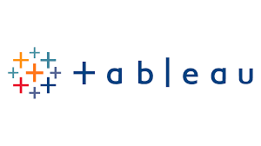





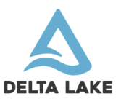






AWS Data Platform Architecture
Data Sources
AWS - Data Platform
Dashboard
AWS Cloud
Virtual private cloud (VPC)
Public API Endpoint
Transformation and Data Processing
Reporting
Data Ingestion
Landing zone
(As-is)
Raw data from source systems
Single Source of Truth
(Cleaned)
Enterprise view of
key business entities
Data Mart
(Business level data)
Ready for consumption
& distribution
Amazon EventBridge
Bronze
Silver
Gold
Amazon Athena
AWS Lambda
AWS Glue
Storage (ACID Transactions,
Time travel, Schema Evolution
& Audit Logging)
Amazon Simple Storage Service (Amazon S3)
Delta Lake
Security and monitoring
(Observability,
Security and access control
of platform)
AWS Secrets Manager
AWS CloudWatch
AWS Shield
Version control & CICD
(Team collaboration,
Automated release between
environments)
AWS CodeCommit
AWS CodePipeline
AWS CodeBuild

Slide 4
Agenda - AWS vs Azure Architecture
1
AWS Data Platform Architecture
2
Azure Data Platform Architecture
3
Cost Estimation - AWS vs Azure

Slide 5


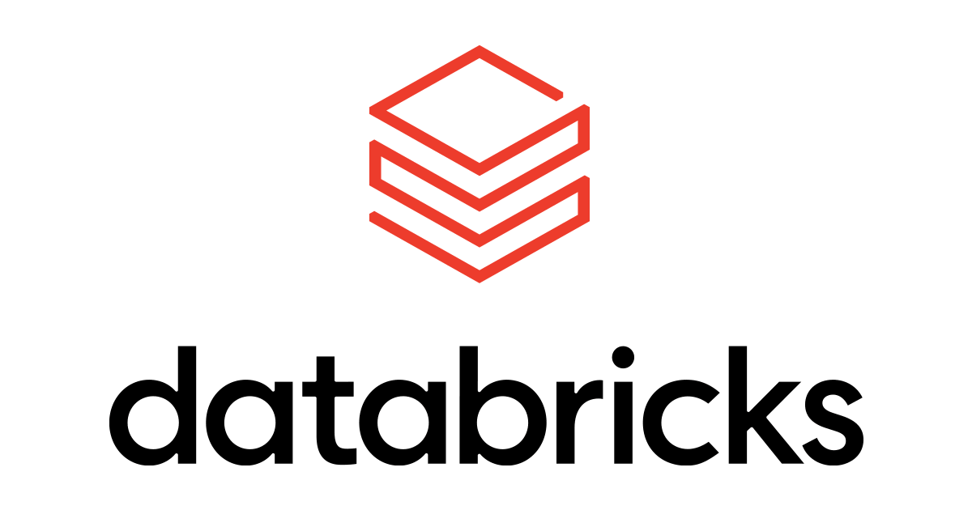










Azure Data Platform Architecture
Data Sources
Azure Databricks - Data Platform
Dashboard
Microsoft Azure
Azure Virtual Network
Transformation and Data Processing
Reporting
Ingestion
Landing zone
(As-is)
Raw data from external source systems
Single Source of Truth
(Cleaned)
Enterprise view of key business entities
Data Mart
(Business level data)
Ready for consumption & distribution
Bronze
Silver
Gold
Metadata & Governance
(Data cataloging, Role-Based
Access Control,
Data Quality Monitoring & Data Lineage)
Data Serving
Public API Endpoint
Unity Catalog
SQL Warehouse
Storage (ACID Transactions,
Time travel, Schema Evolution
& Audit Logging)
Azure Data Lake Storage Gen 2
Delta lake
Secure and monitor
(Observability,
Security and access control
of platform)
Key Vault
Monitor
Defender
Version control & CICD
(Team collaboration,
Automated release between
environments)
Azure Repos
Pull Requests
Azure Pipelines

Slide 6
Agenda - AWS vs Azure Architecture
1
AWS Data Platform Architecture
2
Azure Data Platform Architecture
3
Cost Estimation - AWS vs Azure

Slide 7
AWS vs Azure Data Platform – Cost Comparison
AWS Reference - https://aws.amazon.com/pricing/
Azure Reference - https://azure.microsoft.com/pricing/
Layer | AWS Service | Azure Equivalent | Estimated AWS Cost | Estimated Azure Cost
Data Processing | AWS Glue | Azure Databricks | $88 | $80
Data Storage | Amazon S3 | Azure Data Lake Storage Gen2 | $23 | $23
Data Lake Format | Delta Lake on S3 | Delta Lake on ADLS | $0 | $0
Query Layer | Amazon Athena | Databricks SQL Warehouse | $25 | $40
Governance | AWS IAM / Glue Catalog | Unity Catalog | Included | Included
Secrets Management | AWS Secrets Manager | Azure Key Vault | $4 | $3
Monitoring | AWS CloudWatch | Azure Monitor | $5 | $5
Security Protection | AWS Shield | Microsoft Defender for Cloud | $0 | $10
Version Control | AWS CodeCommit | Azure DevOps | $0 | $0
CI/CD | CodePipeline + CodeBuild | Azure Repos & Pipelines | $11 | $10
Networking | AWS VPC | Azure Virtual Network | $5 | $5
Note: The estimated monthly cost - AWS ~$150/month and Azure ~$170/month, depending on data volume, processing workload, and query frequency.

Slide 8
Thank You

